Slide 1




SCIENCE
FRICTION!

Slide 2
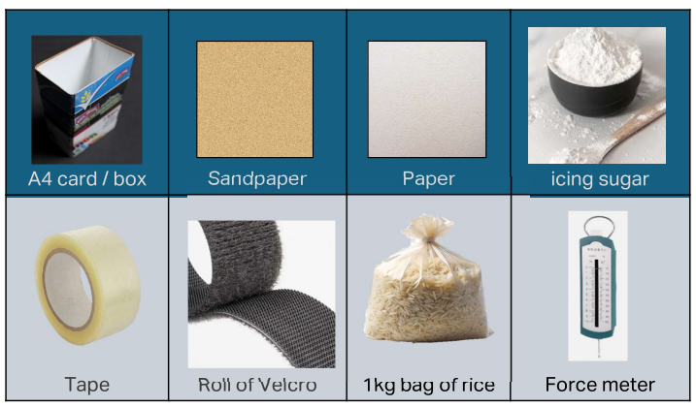
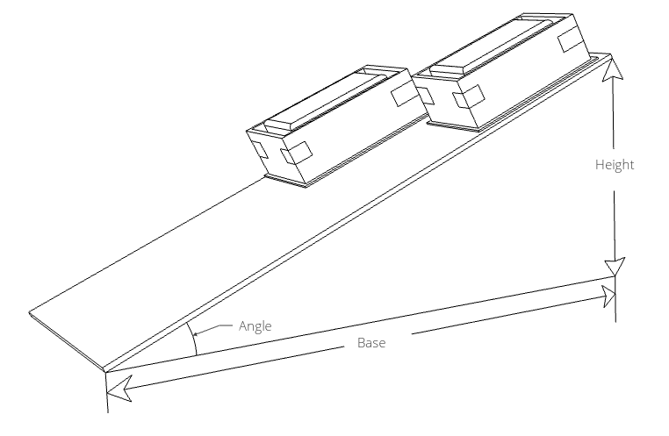

Activity One
Measure the pull force of your sled – use force meter
Activity Two
Test your sled on the dry ramp – try using different surfaces
Activity Three
Test your sled on the lubricated ramp – use icing sugar
Stretch Activity
Calculate the coefficient of friction
MATERIALS + METHODS
Don’t forget to fill in your worksheet

Slide 3
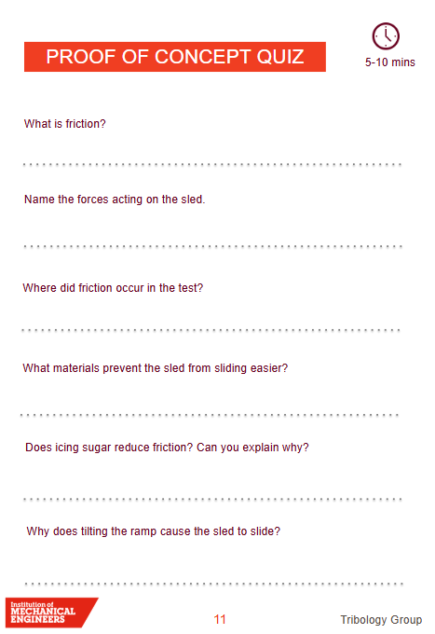

RESULTS + DISCUSSION
“Friction is the resistance that one surface, or object, encounters when moving over another”
Why does tilting the ramp cause the sled to slide?
What materials prevent the sled from sliding easier?
Have you had a go at the stretch activity?

Slide 4
SCIENCE
FRICTION!

