Slide 1




SCIENCE
FRICTION!

Slide 2
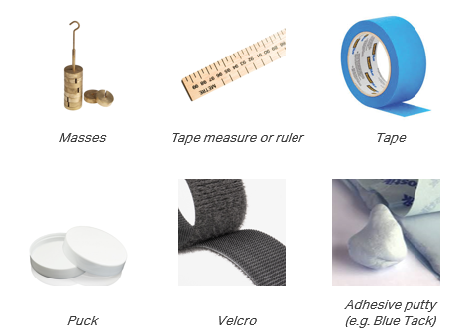
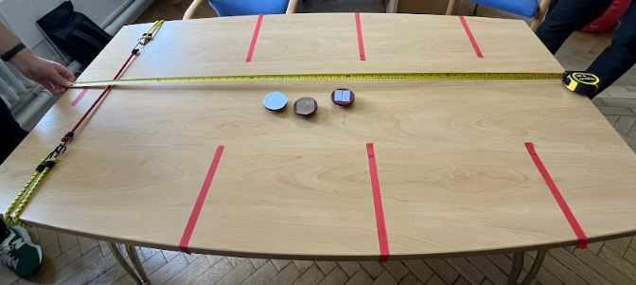

Activity One
Slide with one weight, record the distances travelled.
Activity Two
Slide with three weights, record the distances travelled.
Activity Three
Slide with three weights + Velcro, record the distances travelled.
Activity Four
Slide with whichever loading / surface configuration and try to get as close to the marker as possible.
Stretch Activity
Reducing resistance: Lubrication
MATERIALS + METHODS
Don’t forget to fill in your worksheet

Slide 3
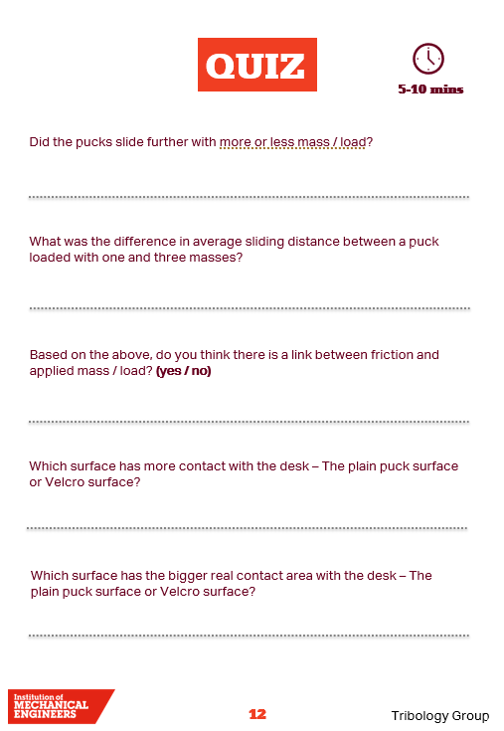
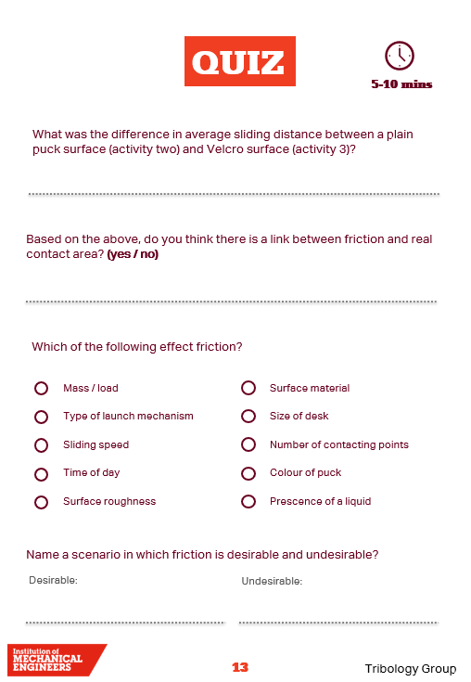
RESULTS + DISCUSSION
“Friction is the resistance that one surface, or object, encounters when moving over another”
Which puck configurations resulted in the most and least friction?
What affect did mass and surface type have on sliding distance?
Have you had a go at the stretch activity?

Slide 4
SCIENCE
FRICTION!

