Slide 1

Apprentice automation challenge monthly report submissions
Notes:
Slide layout: Cover half image
These covers use half page images as backgrounds and can be updated with your own image.
The logo should sit half the logo height from your headline and any content below the logo should be positioned at least the logo height below. This spacing has been built into its placeholder.

Slide 2
Apprentice automation challenge monthly report submissions
01 Meet the team
02 The problem
03 The concept
04 Development
05 Manufacturing
I am happy for the IMechE to share these details online, including the
imeche.org website, Twitter, Facebook, LinkedIn and YouTube channels
(Drag tick into box before saving)
Notes:
Slide layout: Agenda single column

Slide 3
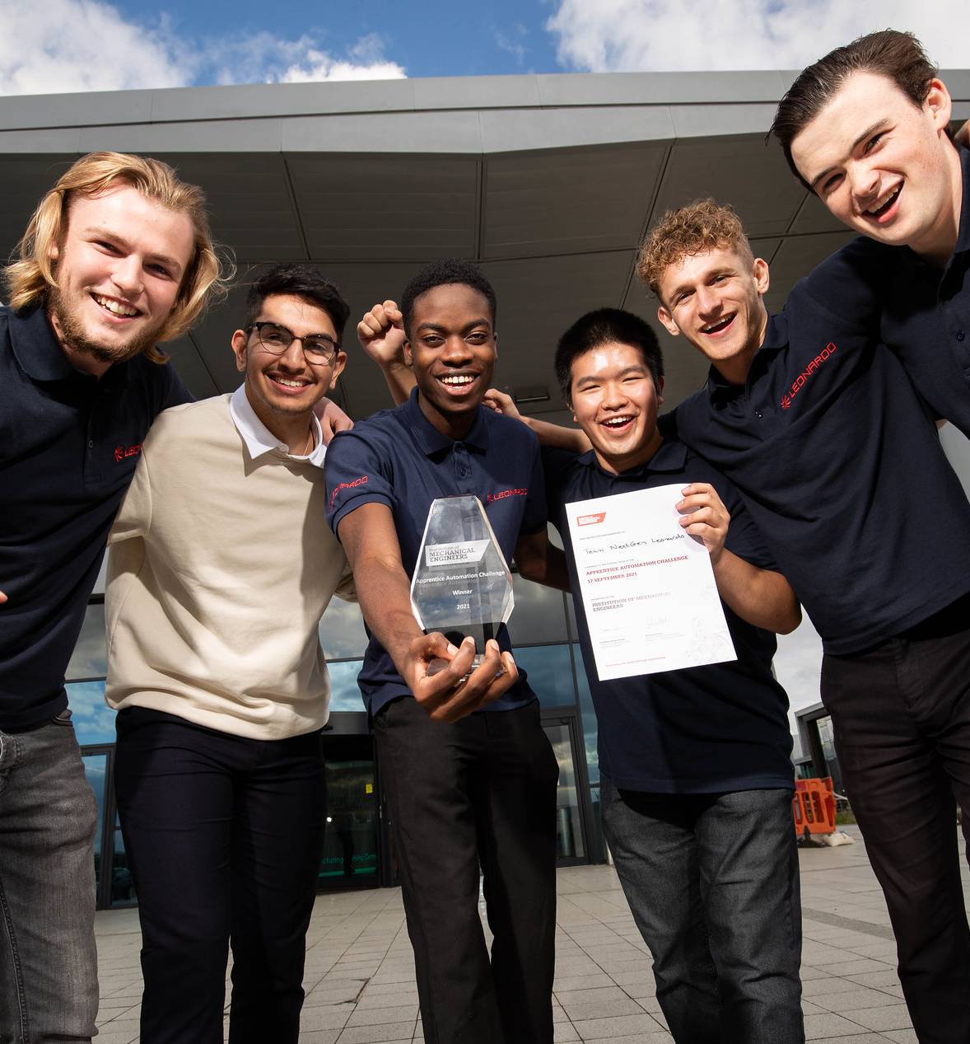
01. meet the team
TEAM NAME
Team bio
Max 250. words
Notes:
Slide layout: Right half inset image

Slide 4

02. THE PROBLEM
Tell us about the problem your device will solve or a process it will automate in max. 250 words

Slide 5
03. THE CONCEPT
Tell us about your concept in max. 250 words

Slide 6
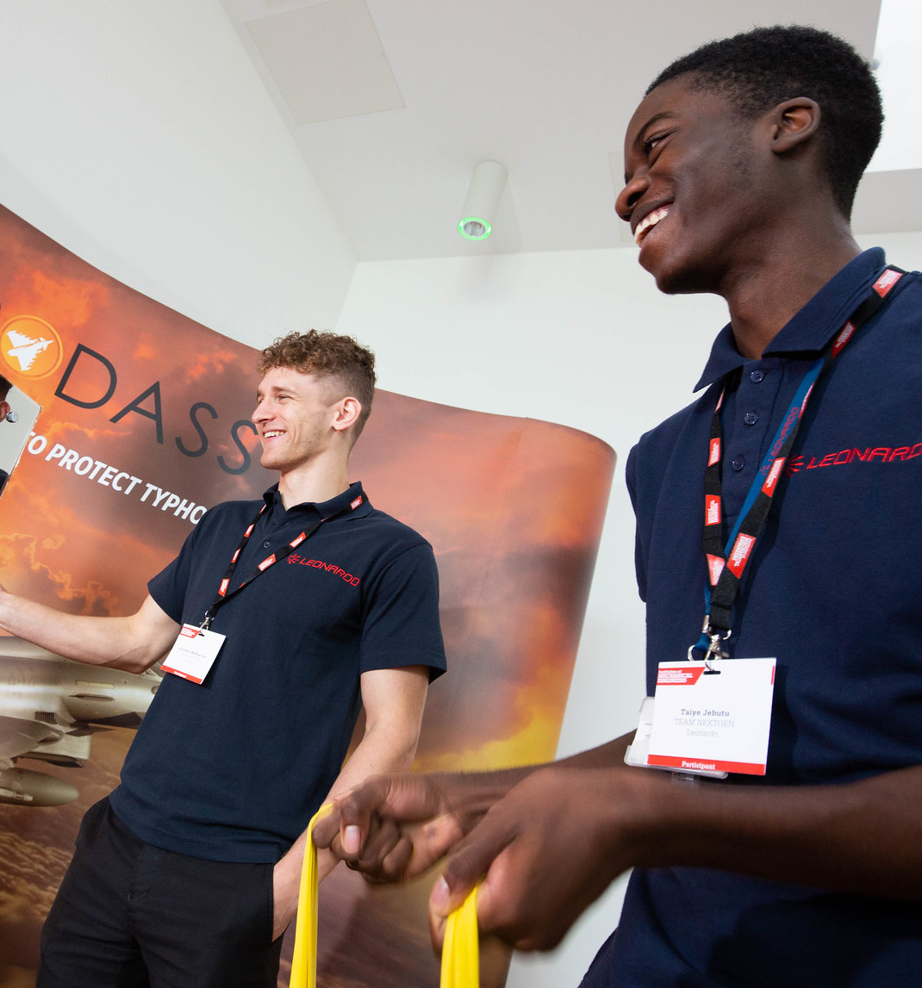
04. DEVELOPMENT
Tell us about how your concept and designs have developed or perhaps how your team has developed in max. 250 words

Slide 7
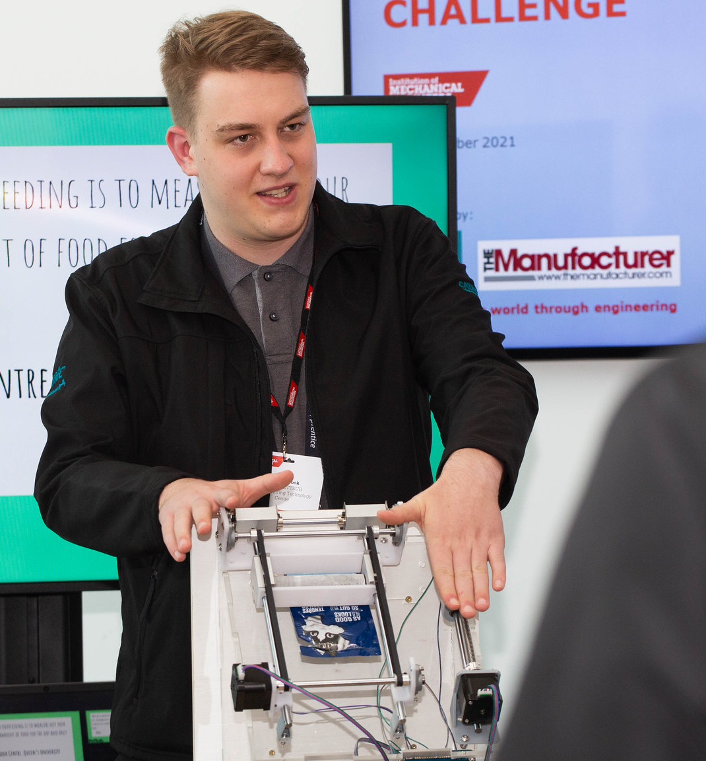
05. MANUFACTURING
Tell us about the manufacturing process and your readiness for competition in max. 250 words

