Slide 1




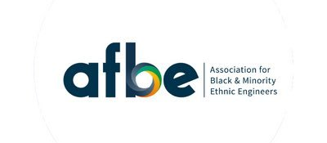

Inclusion Moment

Slide 2
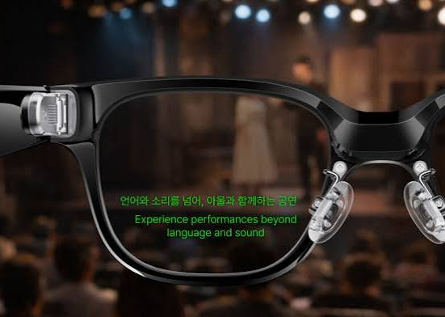
Does ai support inclusion in engineering?
AI is only as inclusive as the people who build it.
Inclusive outcomes depend on who is in the room making design decisions and whose perspectives shape the system.
Yet AI also offers powerful tools for inclusion when designed intentionally.
With thoughtful choices, AI can widen access, support diverse needs, and help more people participate fully in engineering.
AI can remove barriers, but it can also create new ones.
Poorly designed systems can reinforce bias or exclude users, even when the intention was to help.
AI‑powered augmented‑reality glasses that generate real‑time subtitles
What do you think – does AI support inclusion in engineering?
Notes:
Does AI Really Support Inclusion in Engineering?
Artificial intelligence is often described as a big step forward for engineering — not just for speed and efficiency, but for inclusion. The idea is appealing: AI that helps remove barriers, gives more people a voice, and supports engineers in building technology that works for everyone. But the reality is more complicated, and worth looking at honestly.
AI is only as inclusive as the people who build it.
If the teams designing AI don’t reflect the people who will use it, the systems can miss important needs. We already see this in everyday tools: speech‑recognition systems that struggle with certain accents, image‑recognition models that make more mistakes with darker skin tones, and software that simply doesn’t work well with screen readers or other assistive technologies. These problems happen because the people affected weren’t included in the design process.
Yet AI can also be a powerful tool for inclusion when it’s designed with care.
Some technologies show what’s possible when inclusion is a priority. For example, AI‑powered glasses that display live subtitles can make meetings far more accessible for Deaf and hard‑of‑hearing engineers. Tools that break tasks into smaller steps or simplify complex interfaces can help neurodiverse engineers stay focused and reduce cognitive load. And real‑time translation can make global teamwork smoother and more equal.
AI can remove barriers — but it can also create new ones.
AI can make things easier, but it can also make things harder if we don’t think ahead.
Where AI genuinely helps
It can adjust how information is shown so people with different accessibility needs can use tools more comfortably.
It can provide live captions or translations so more people can fully take part in conversations.
It can spot unfair patterns in hiring or promotion that humans might overlook.
It can support different working styles by offering personalised ways to organise tasks or communicate.
Where AI can cause problems
If the data it learns from is biased, the system will be biased too.
If certain groups aren’t involved in development, their needs may never be considered.
If workplaces rely heavily on AI tools, people who can’t access them — or who find them difficult to use — may be left out.
If AI behaves unpredictably, it becomes harder to check whether it’s fair or accessible.
So, does AI support inclusion in engineering? What do you think?

Slide 3

Inclusion isn’t accidental — it’s engineered.
AI only becomes inclusive when teams design it that way.
Identify where exclusion happens.
Involve diverse users early and often.
Build accessibility and equity into every stage.
Test with real people, not assumptions.
When inclusion is prioritised, tools like AR subtitle glasses show what’s possible.
When it isn’t, AI can deepen inequality.
The real question for engineering teams is:
Are we building AI in a way that ensures inclusion happens?
Notes:
Inclusion doesn’t happen by accident.
AI becomes inclusive when engineers deliberately design for it — spotting exclusion early, involving diverse users, and building accessibility into every stage. Tools like AR subtitle glasses show what’s possible when inclusion is prioritised. Without diverse voices shaping AI, the same tools can deepen inequality.
So the question isn’t “Will AI make us more inclusive?”
It’s “Are we designing AI so inclusion is guaranteed?”

Slide 4
Thank you.
diversity@imeche.org
imeche.org

